Slide 1
Reopening Guidelines for Santa Barbara County
Created by Nathan Cao, PublicSquare Reopening Ambassador

Slide 2
All reopening information can be found online: recoverysbc.org

Slide 3
Before Reopening All Facilities Must
1. Perform a detailed risk assessment and implement site-specific COVID-19 protection plan
2. Train employees on how to limit the spread of COVID-19, including how to screen themselves for symptoms and stay home if they have them
3. Implement individual control measures and screenings
4. Implement disinfecting protocols
5. Implement physical distancing guidelines

Slide 4
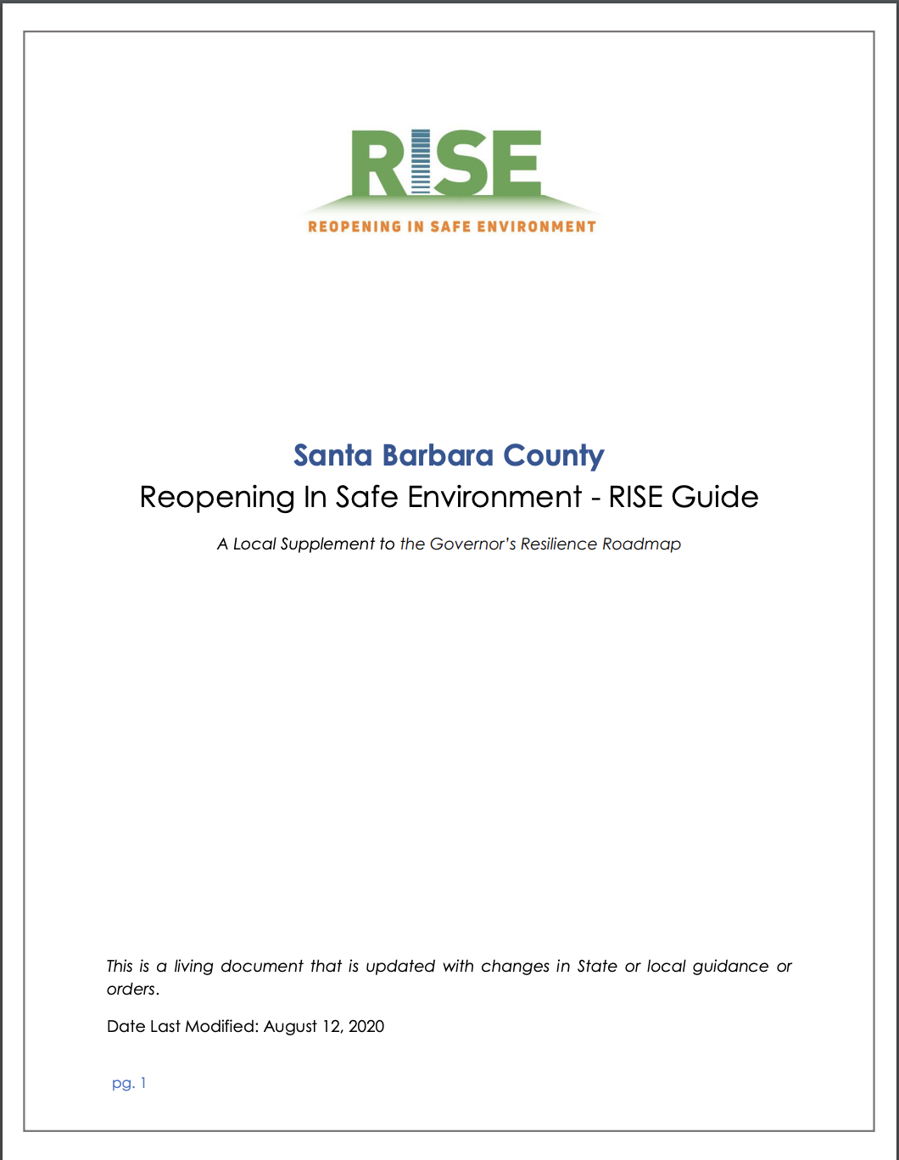
Please read the RISE Guide which outlines the steps for reopening that can be safely taken in our community
https://recoverysbc.org/the-rise-guide/

Slide 5
How to RISE
1. Review guidance published by the State of CA and the County of SB
2. Perform a detailed risk assessment in accordance with the state guidelines for your industry and prepare a COVID-19 protection plan based on the guidance
3. Implement a site-specific COVID-19 protection plan
4. Review your industry specific guidance and complete your industry specific checklist
5. Complete the attestation by completing this form
6. Post the industry specific checklist and the attestation at your business to show your customers and employees you have reduced the risk and are open for business
7. An official from your local jurisdiction may conduct a site visit

Slide 6
Waivers
According to Trevor D. Large of Fauver, Large, Archbald & Spray, LLP
1. Employee Waivers- not likely to be effective
In California, personal injury waiver is not effective, thus we have workers compensation
2. Contractors/Vendors Waivers - can be effective depending on existing agreements
Possible to amend a COVID agreement within the pre-existing contract with mutual agreement on both sides
3. Customer/Visitor Waivers (“sign before entering” waiver) - effective but complicated
Be careful about overreaching on a customer’s bargaining power
If you are an essential business, you may not be able to obtain a customer waiver

Slide 7
Premises Liability
According to Trevor D. Large of Fauver, Large, Archbald & Spray, LLP
Premises liability = “businesses owe a duty of care to their patrons/cannot expose them to known or obvious danger”
Practical Considerations
1. Comply with federal, state, and local guidelines
2. Consider actions taken from competitors
3. Consider following most restrictive guidelines
4. Post warnings
5. Check insurance to see if pandemic protection exists

Slide 8
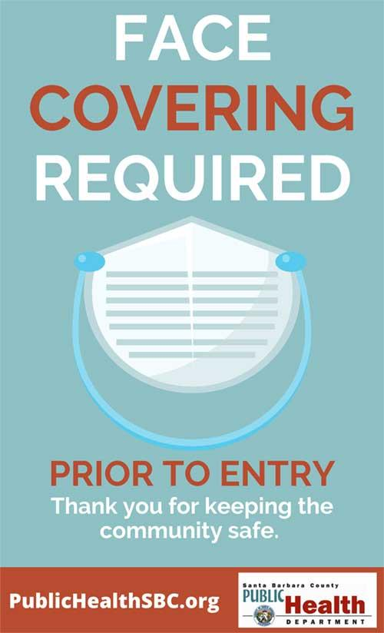
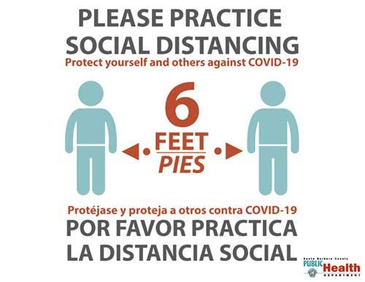
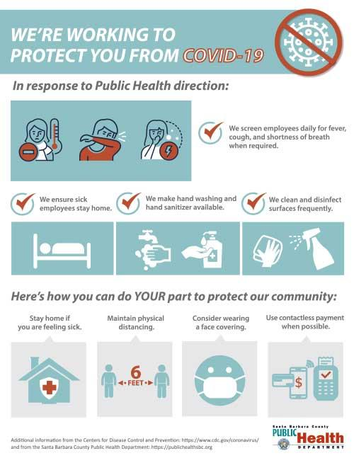
Mandatory Signage
-Per the State of California and the County of Santa Barbara Health Mandates
-PDFs can be downloaded and printed online at “recoverysbc.org/signs/”

Slide 9
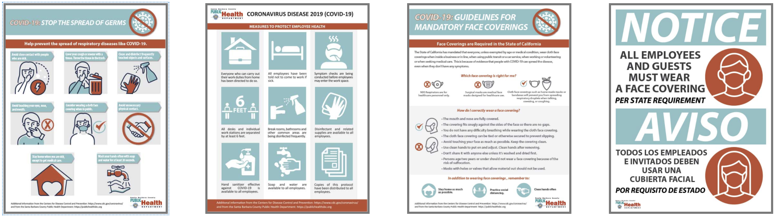
Informational Signage (optional)

Slide 10
Small Business and Community Enhancement Program (SBCPEP)
Apply to Santa Barbara County’s SBCPEP, a new voluntary program, to allow your business or organization to expand into adjacent outdoor areas in the unincorporated areas of the county to accommodate required social distancing protocols and safe practices
Requirement:
Only businesses authorized to open under the Governor’s Reopening Plan and
County’s RISE Guide will be granted a permit, however all may submit an application now to prepare for reopening
Phase 1 - Public Roadside or Sidewalk Areas
Phase 2 - Private Property (ex. Parking Lots)

Slide 11
Assembly Bill 1035 (Pending)
According to Trevor D. Large of Fauver, Large, Archbald & Spray, LLP
If passed as a law, AB 1035 will provide liability exemption for small businesses
Small businesses are those with 25 or fewer employees
Businesses must comply with all state and local health laws
Not liable for COVID infections on premises
Does not apply to gross negligence, intentional acts, or discriminatory conduct

Slide 12
Questions? Please call (833) 688-5551 to speak to a RISE Ambassador

Slide 13
Sponsored by
PublicSquare COVID-19
Equity Internship Project

